Slide 1
Data Manipulation

Slide 2
File Formats

Slide 3
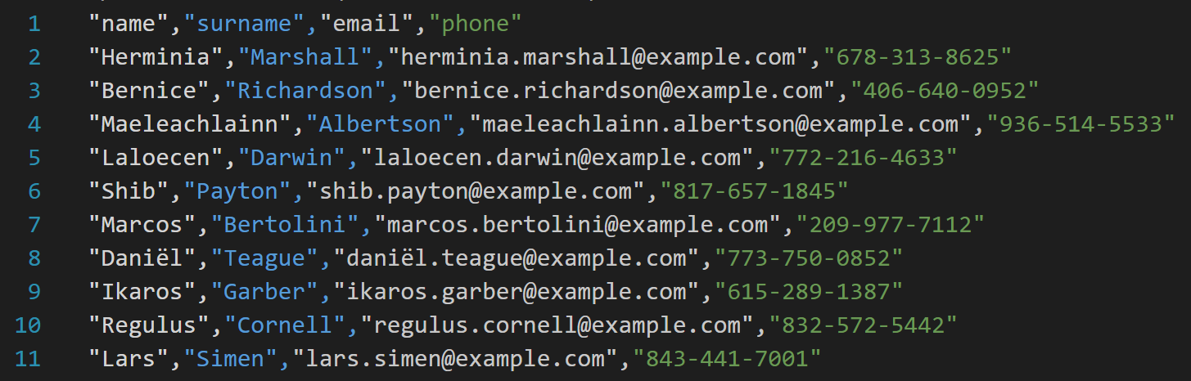
.csv

Slide 4
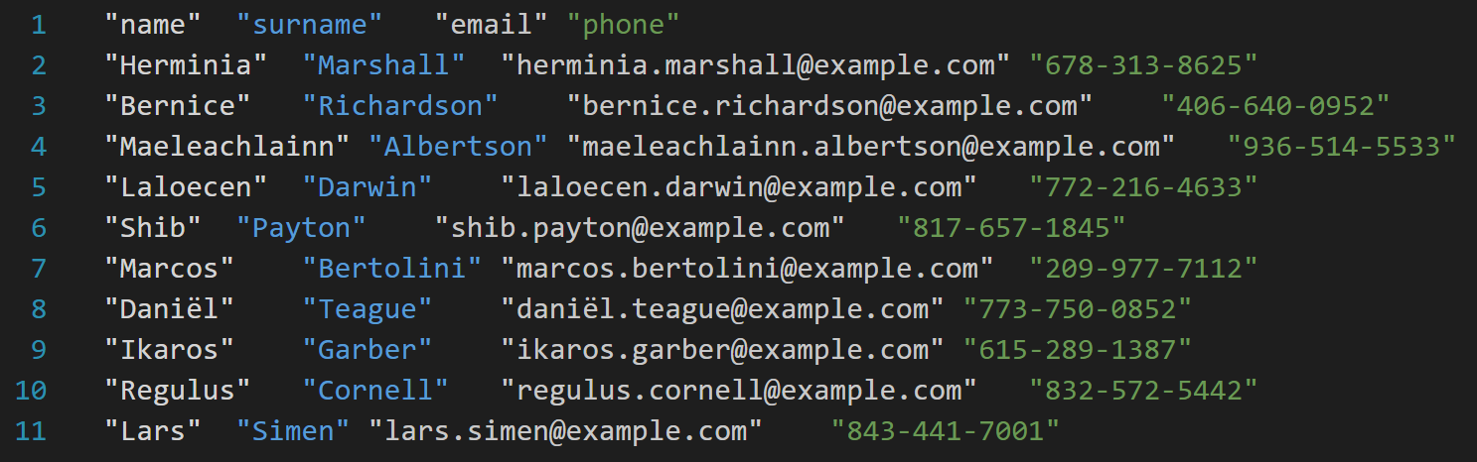
.tsv

Slide 5
.json

Slide 6
.xlsx

Slide 7
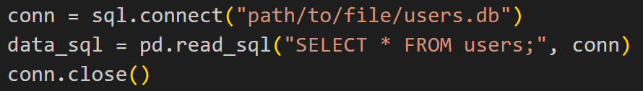
SQL

Slide 8
URL

Slide 9
How to assess data quality

Slide 10
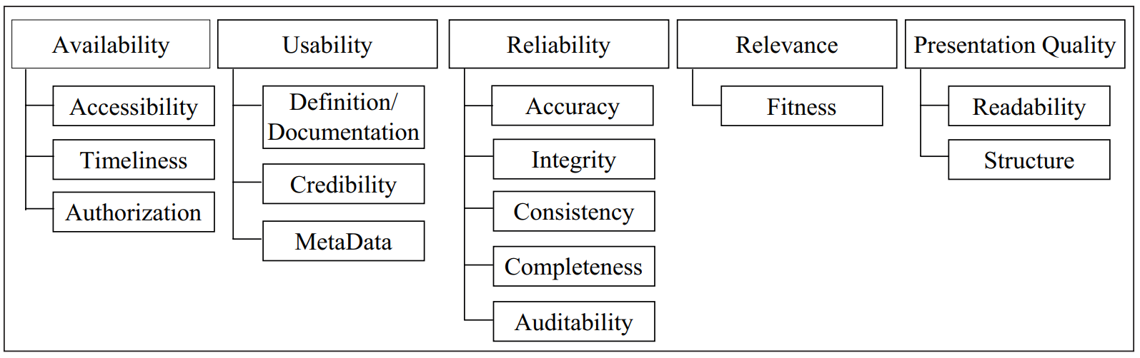
How to assess data quality

Slide 11
Availability

Slide 12
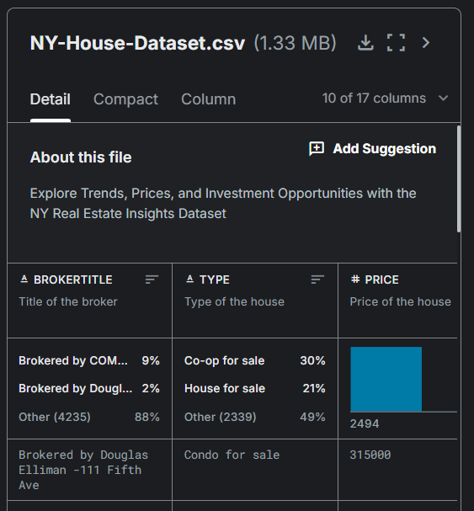
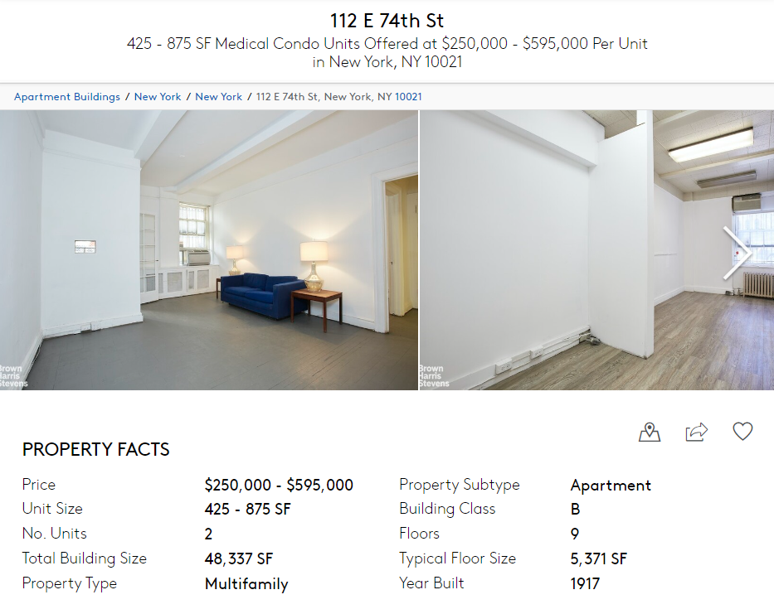

Accessibility

Slide 13
Timeliness

Slide 14
Timeliness
My super model for predicting house prices
2024

Slide 15
Timeliness
2012
My super model for predicting house prices
My data 🙁
2024

Slide 16

Authorization

Slide 17
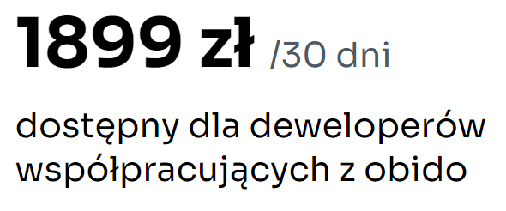
Authorization

Slide 18
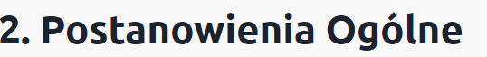
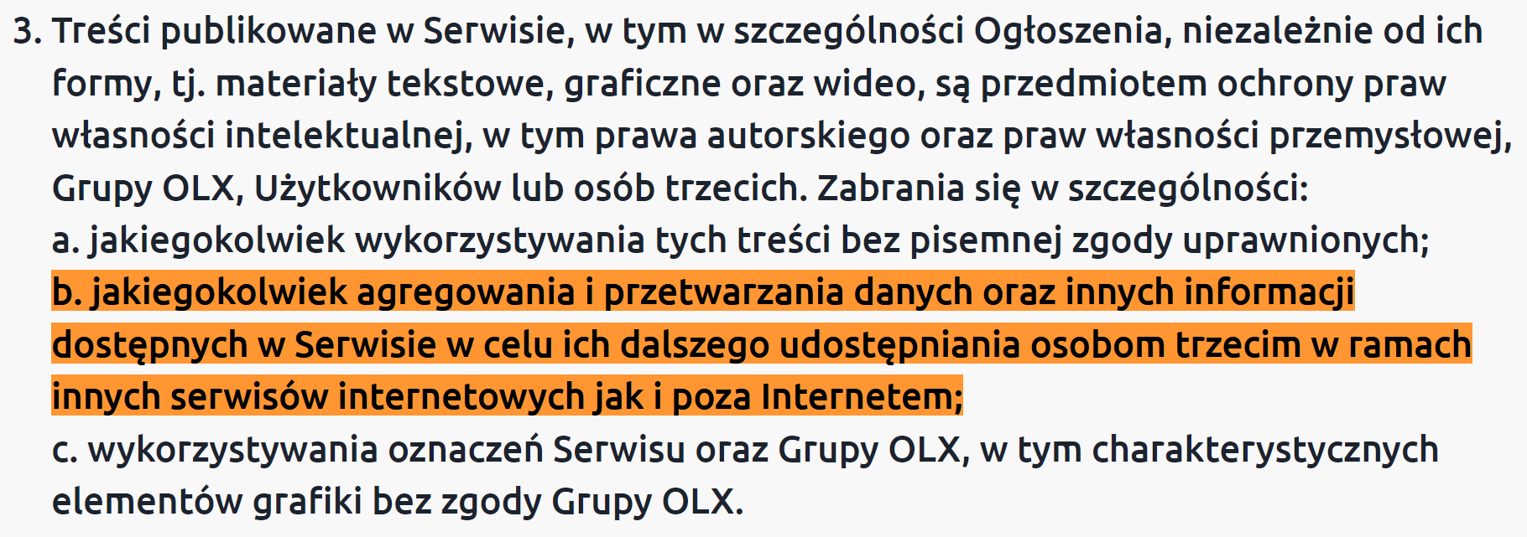
Authorization

Slide 19
Usability

Slide 20

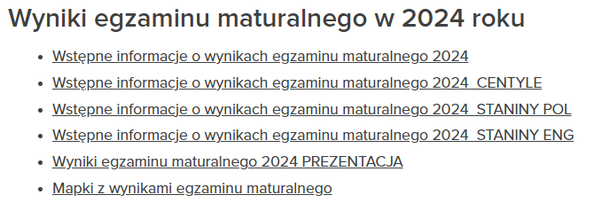
Credibility

Slide 21
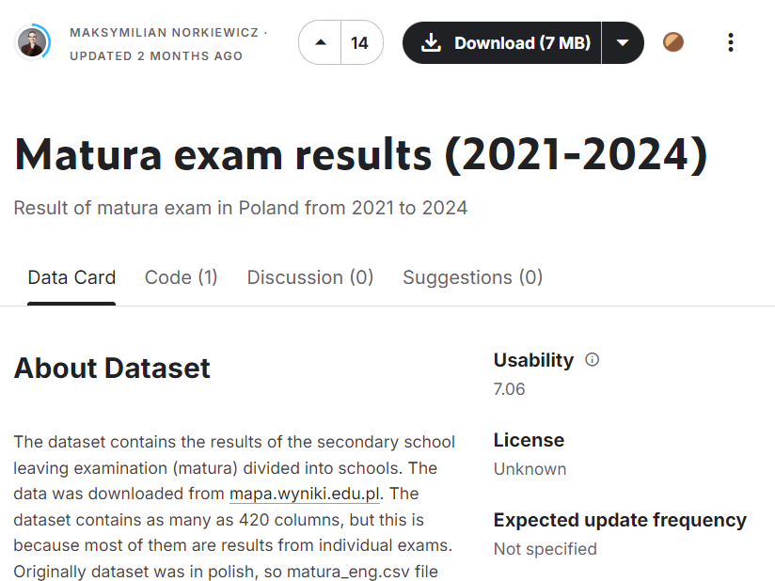
Credibility

Slide 22
Credibility
👍
👎

Slide 23
Reliability

Slide 24
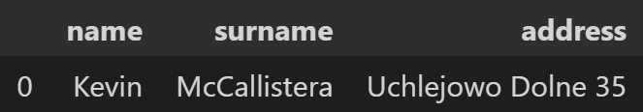
Accuracy

Slide 25

Accuracy

Slide 26
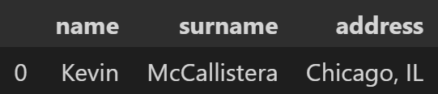
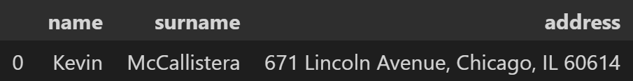
Accuracy

Slide 27




Accuracy

Slide 28

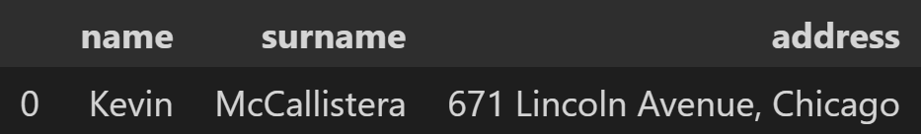
Consistency
1

Slide 29
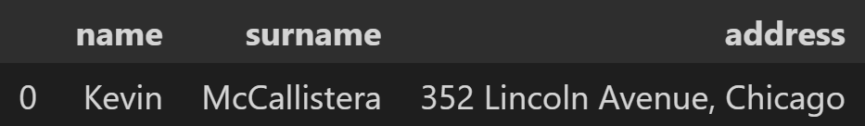
Consistency
1
2

Slide 30
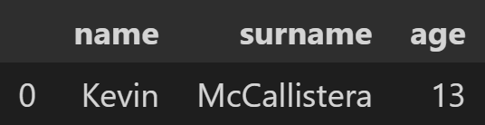
Consistency

Slide 31
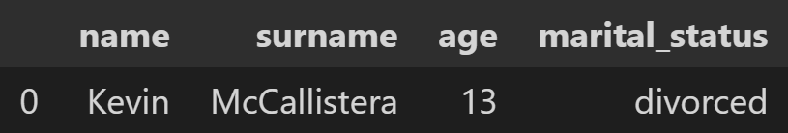
Consistency

Slide 32
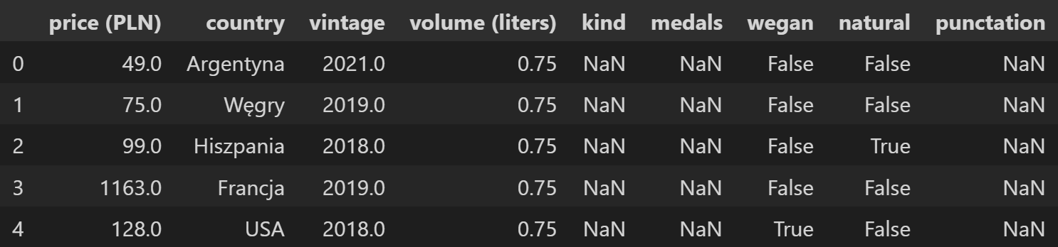
Completeness

Slide 33
Presentation Quality

Slide 34
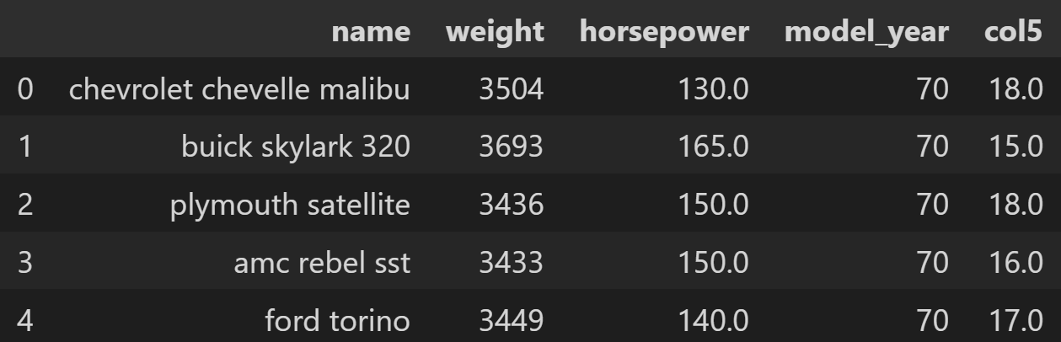
Readability

Slide 35
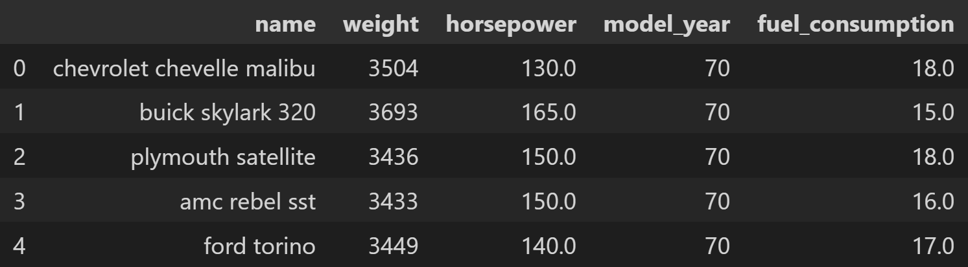
Readability

Slide 36
Readability
l/100km (liters per 100km)
MPG (miles per gallon)

Slide 37

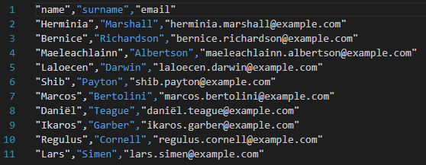
Structure
.csv, .tsv

Slide 38
Structure
SQL

Slide 39
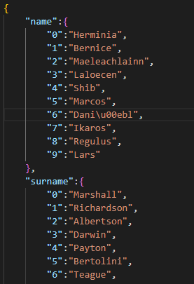
Structure
.json

Slide 40
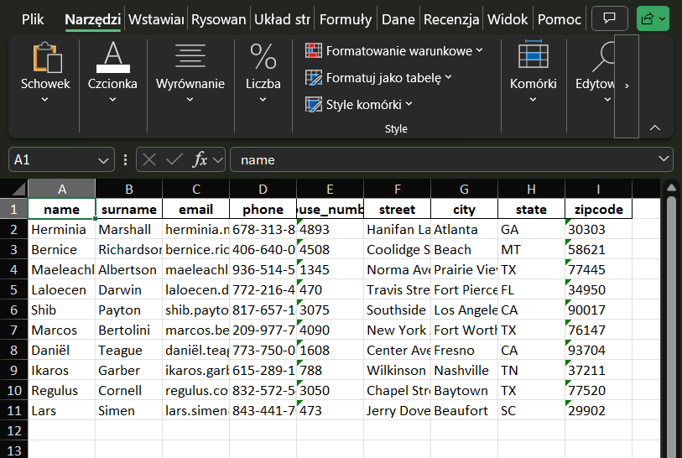
Structure
Excel

Slide 41
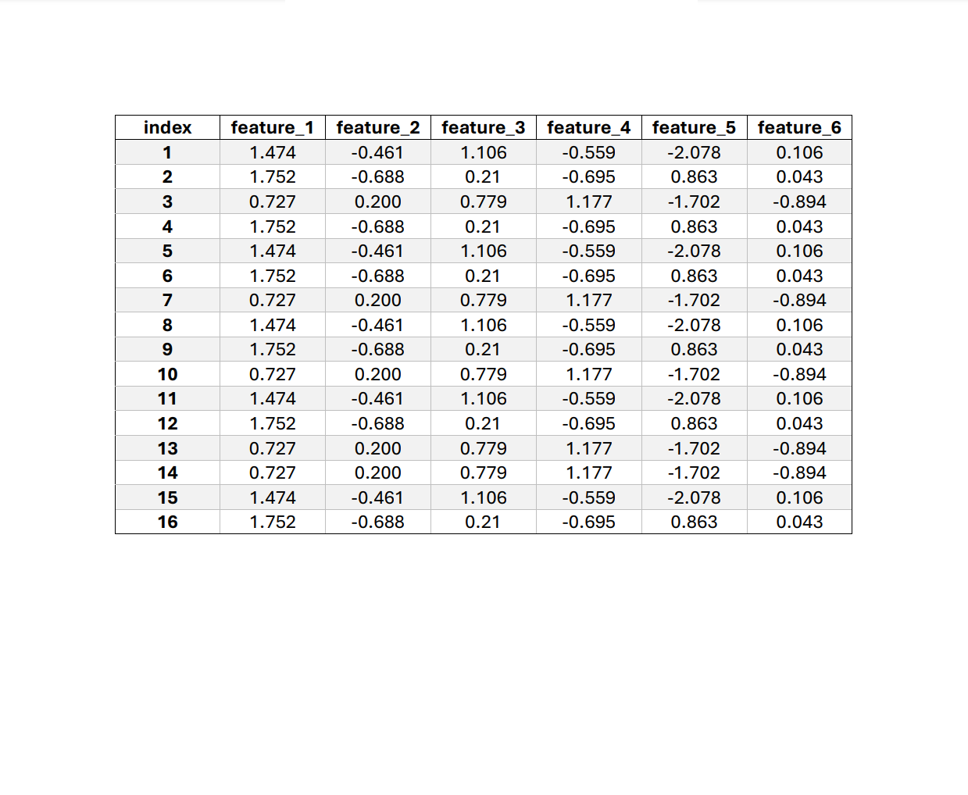

Structure
.pdf

Slide 42
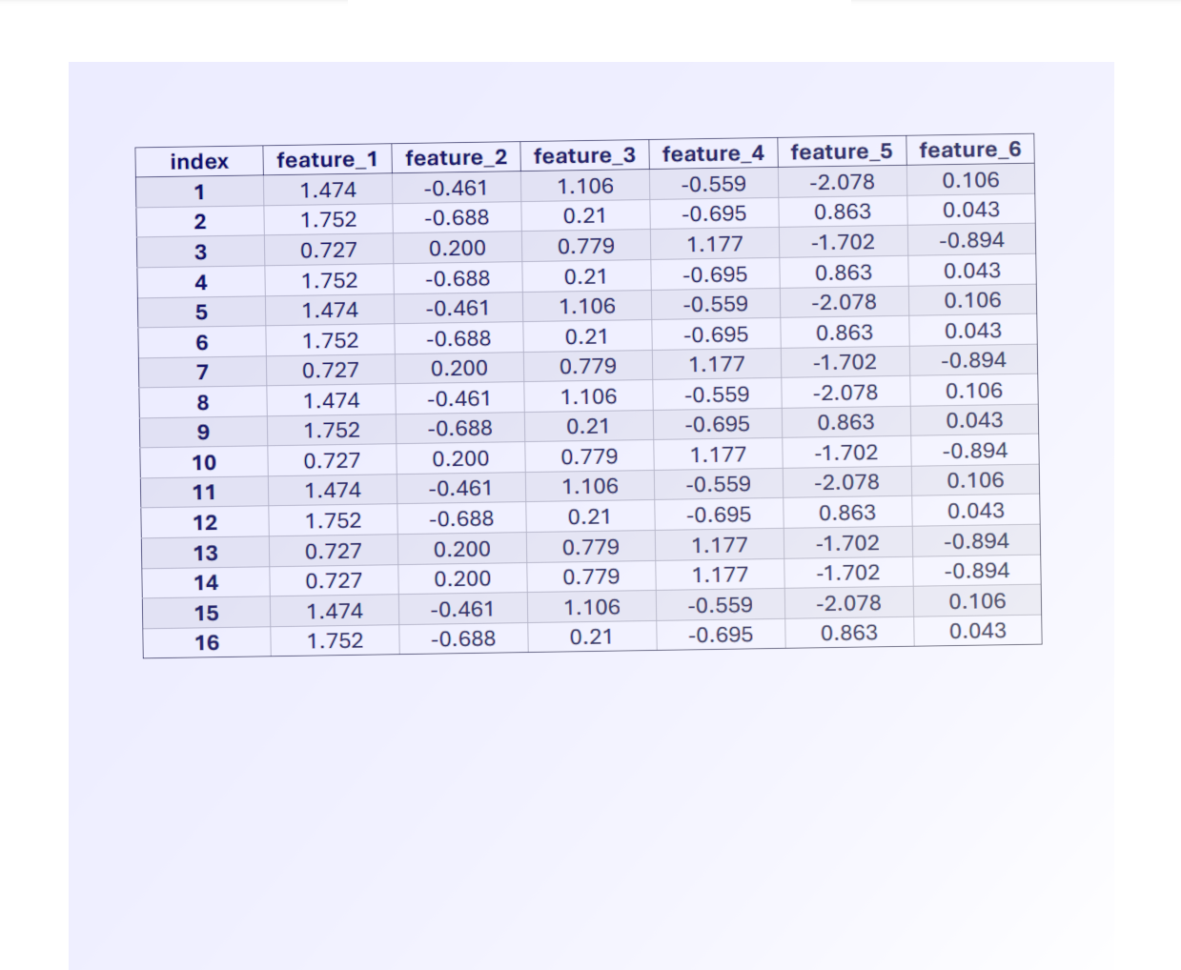
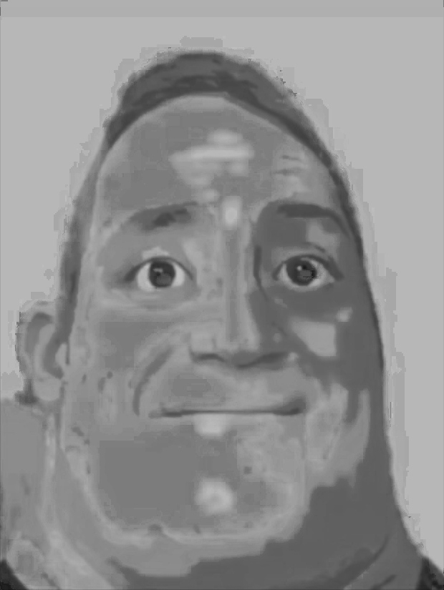
Structure
.pdf

Slide 43
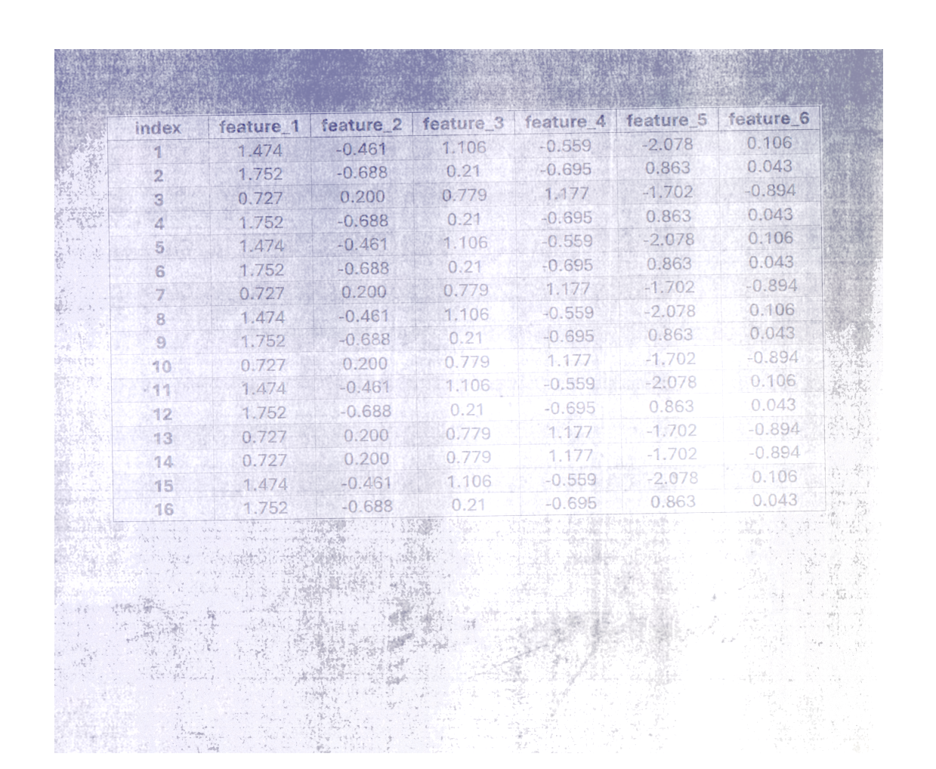

Structure
.pdf

Slide 44
Data cleaning

Slide 45



From unstructured data to structured data

Slide 46
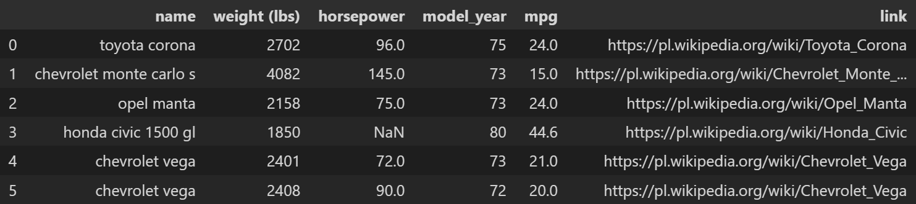
Removing irrelevant data

Slide 47
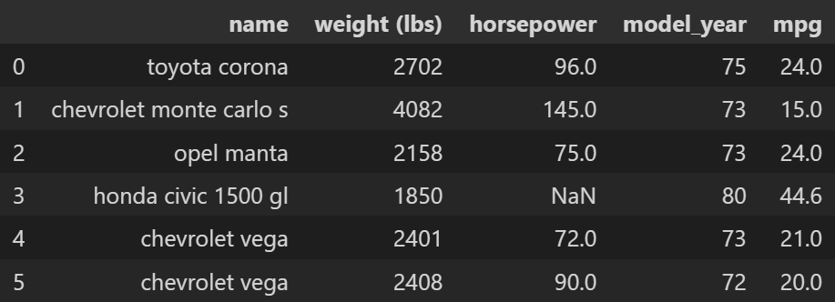
Removing irrelevant data

Slide 48
Removing duplicates

Slide 49
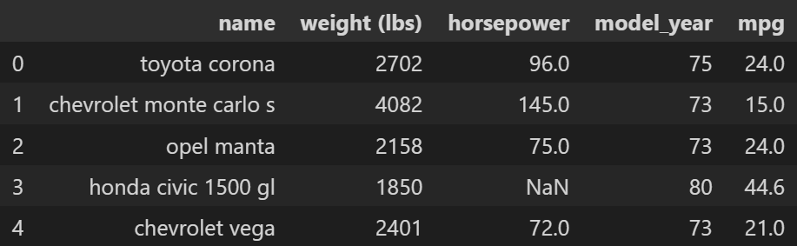
Removing duplicates

Slide 50
Removing duplicates

Slide 51
Type conversions
numpy.int64

Slide 52
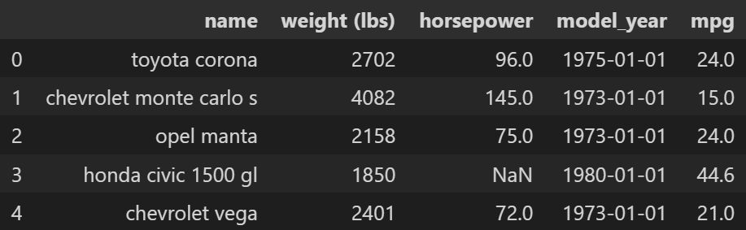
Type conversions
pandas._libs.tslibs.timestamps.Timestamp

Slide 53
Units conversion

Slide 54
Units conversion
pounds
mile per gallon

Slide 55
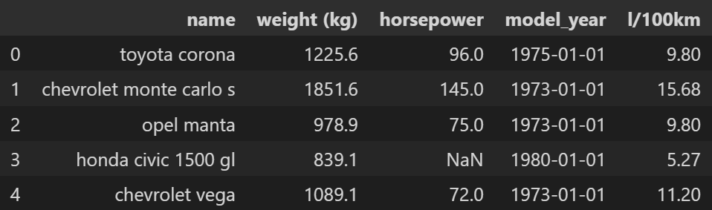
Units conversion
kilograms
liters per 100 km

Slide 56
Dealing with missing values

Slide 57
Dealing with missing values

Slide 58
Dealing with missing values
Delete

Slide 59
Dealing with missing values
Delete or Impute

Slide 60
Deleting rows

Slide 61
Deleting columns

Slide 62
Imputing value

Slide 63
Mean

Slide 64
Mean

Slide 65
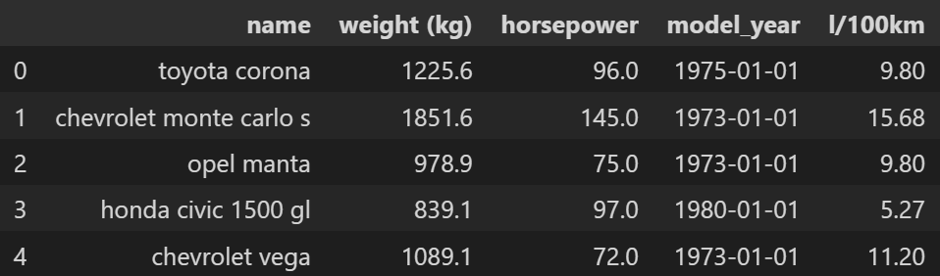
Mean

Slide 66
Median

Slide 67

Median

Slide 68
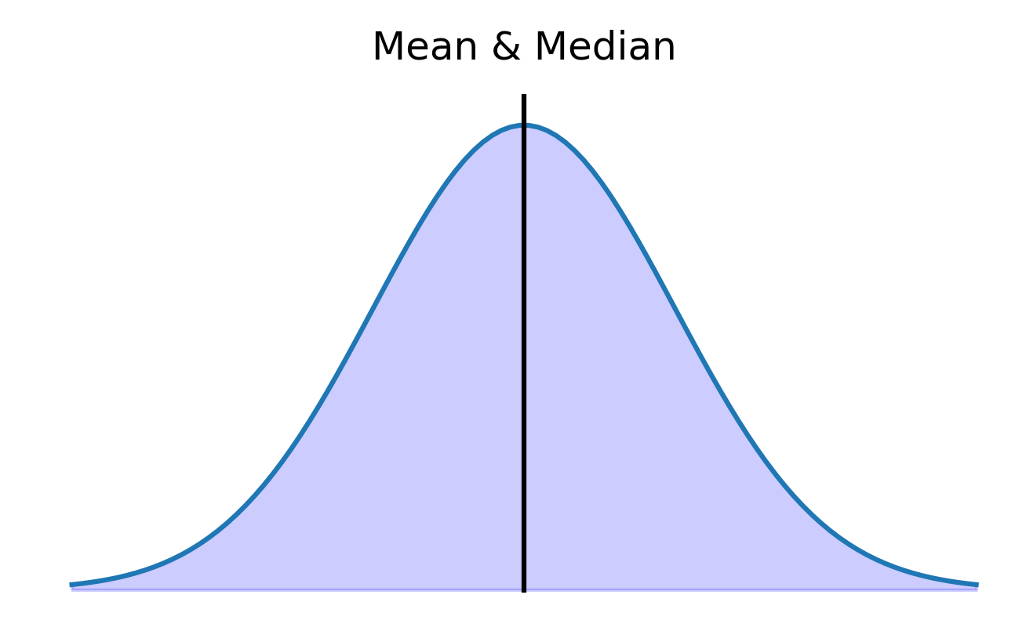
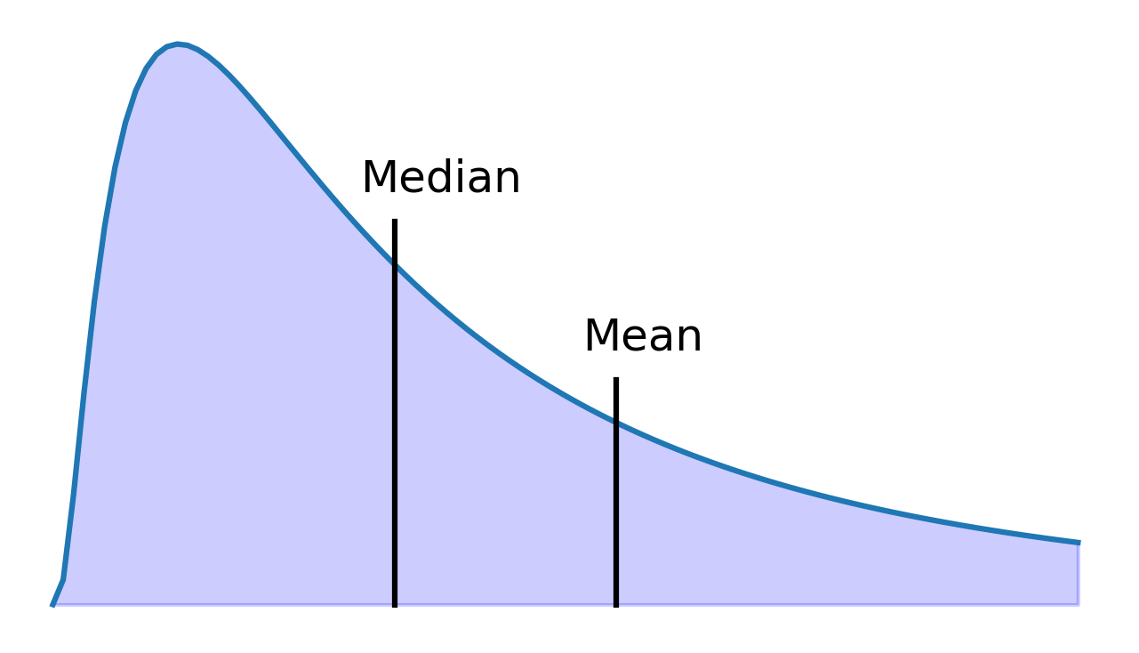
Mean vs. Median

Slide 69
Generate random numbers
μ = 97

Slide 70
Generate random numbers
μ = 97
σ = 34

Slide 71
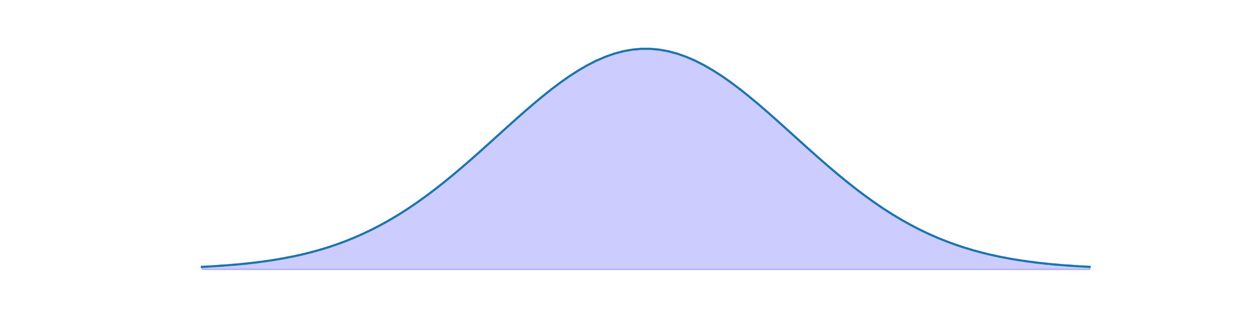
Generate random numbers
μ = 97
σ = 34

Slide 72
Generate random numbers
μ = 97
σ = 34
1.1

Slide 73
Linear regression

Slide 74
Linear regression
training features

Slide 75
Linear regression
training features
training targets

Slide 76
Linear regression
training features
training targets
features for prediction

Slide 77
Linear regression
training features
training targets
features for prediction
missing values

Slide 78
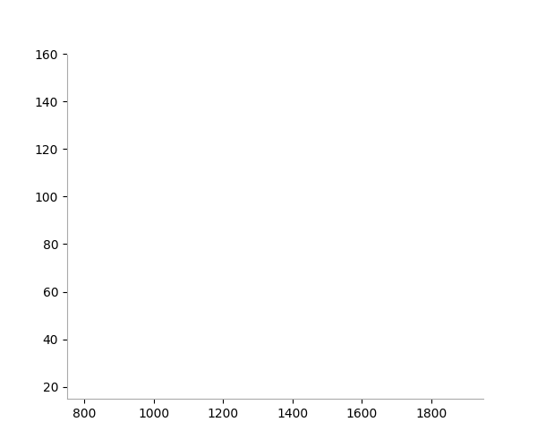
Linear regression

Slide 79
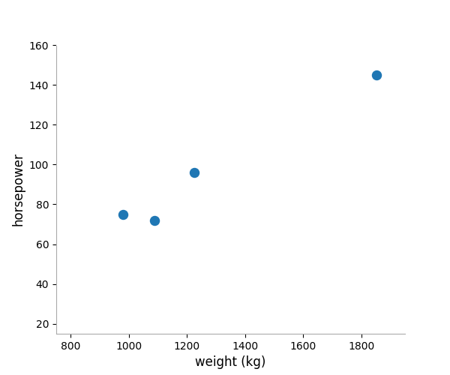
Linear regression

Slide 80
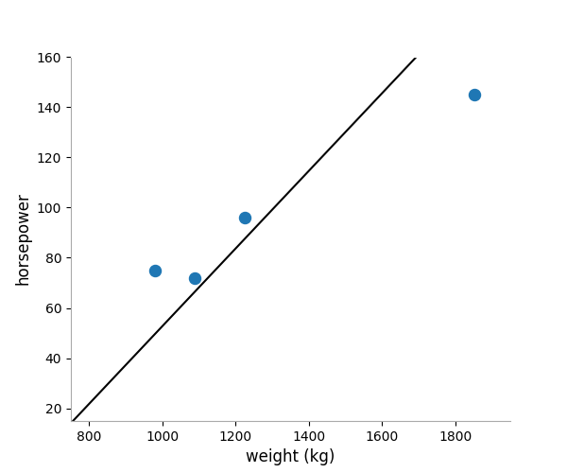
Linear regression

Slide 81
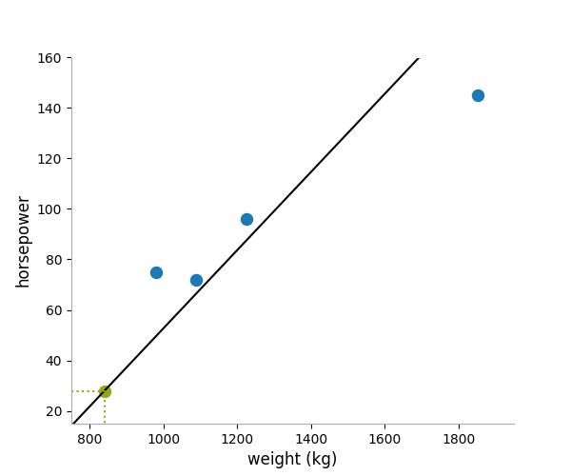
Linear regression

Slide 82

Linear regression

Slide 83
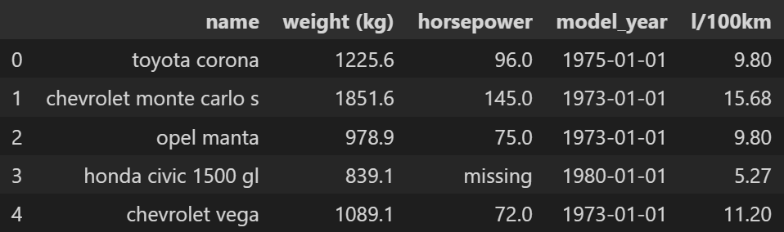
Flags

Slide 84
References
https://towardsdatascience.com/the-ultimate-guide-to-data-cleaning-3969843991d4
https://towardsdatascience.com/an-extensive-guide-to-exploratory-data-analysis-ddd99a03199e
https://account.datascience.codata.org/index.php/up-j-dsj/article/view/dsj-2015-002
https://www.sbctc.edu/resources/documents/colleges-staff/commissions-councils/dgc/data-quality-deminsions.pdf

